Slide 1
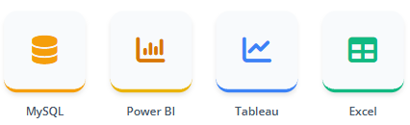
HR Analytics Dashboard
Project Overview
This project focuses on analyzing employee attrition, salary trends, and workforce performance.
The objective is to extract meaningful insights using SQL and present them through interactive dashboards in Power BI, Tableau, and Excel.
Employee Attrition & Workforce Analysis
GROUP NO.: -2
Ayushi Ajay Mundhada
Sayali Sangole
Piyush Dave
Kumud Kundan Patil
Amanveer Pratap
Jaffer Mydeen A
N.Ventaka Lakshmi
Tools & Technologies

Slide 2
Agenda
7. KPI 5 – Work-Life Balance by Job Role
Presentation Outline
8. KPI 6 – Attrition vs Years Since Promotion
1. Project Overview
9. Power BI Dashboard Overview
2. Agenda
10. SQL Queries Used
3. KPI 1 – Attrition Rate by Department
11. Tableau Dashboard Overview
4. KPI 2 – Average Hourly Rate by Research Scientist
12. Excel Dashboard Overview
5. KPI 3 – Attrition by Income Category
13. Business Conclusions & Recommendations
6. KPI 4 – Avg Working Years by Department
14. Challenges Faced & How We Overcame Them

Slide 3
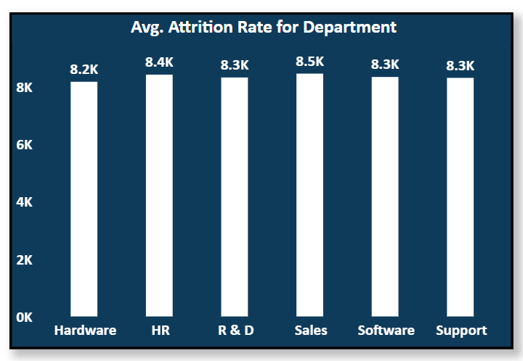
KPI 1 – Attrition Rate by Department
Key Observations
Sales and HR departments show higher attrition rates.
R&D and Software departments have relatively stable employees.
Department workload and pressure may influence attrition
Business Insight
High attrition in certain departments indicates role-specific challenges like workload and pressure.
Targeted retention strategies and better management support can reduce employee turnover

Slide 4
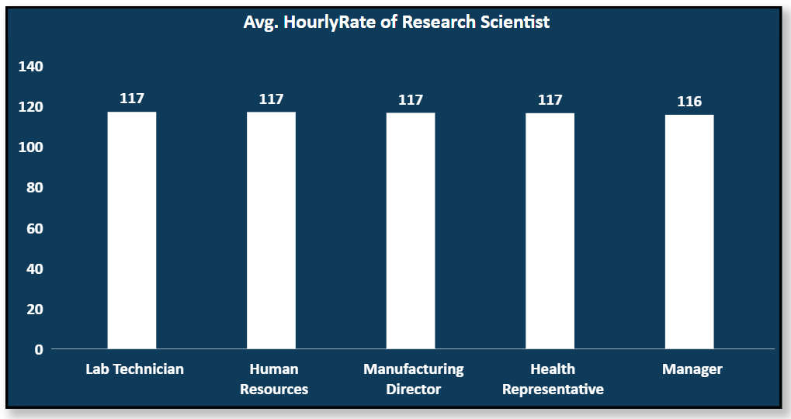
KPI 2 – KPI 2: Avg Hourly Rate
Key Observations
Average hourly rate varies significantly across job roles and departments.
Higher-paying roles generally show better retention.
Some roles may be underpaid compared to workload.
Business Insight
Differences in pay across roles may lead to dissatisfaction and higher attrition.
Ensuring fair and competitive salaries can improve motivation and retention.

Slide 5
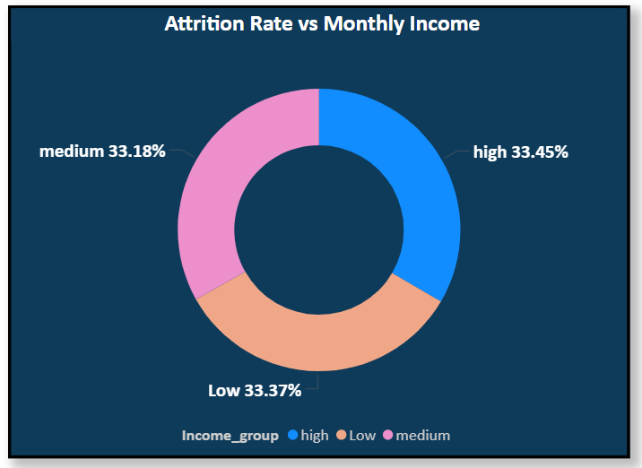
KPI 3 – Attrition by Income Category
Key Observations
Employees in the low-income category have the highest attrition rate.
Medium-income group shows moderate attrition.
High-income employees are more stable and less likely to leave.
Business Insight
Higher attrition in low-income groups shows salary is a key factor in employee exits.
Improving compensation and benefits can help retain employees.

Slide 6
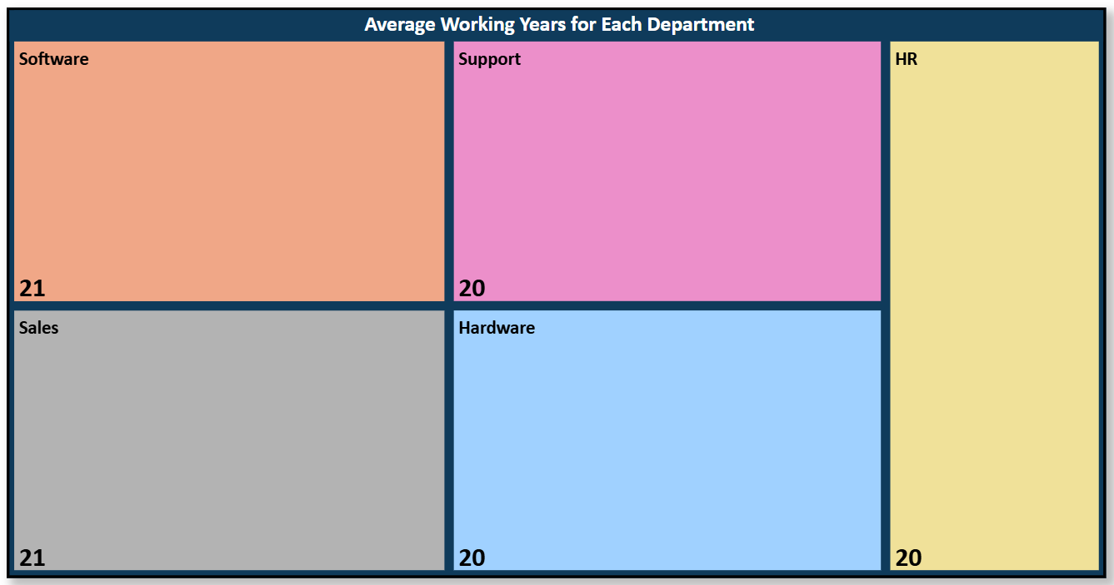
KPI 4 – Average Working Years by Department
Key Observations
Some departments have higher average tenure, indicating strong retention.
Others show lower tenure, suggesting frequent employee exits.
Experience level varies significantly across departments.
Business Insight
Departments with higher tenure reflect better work environment and management.
Adopting similar practices can improve retention across the organization

Slide 7
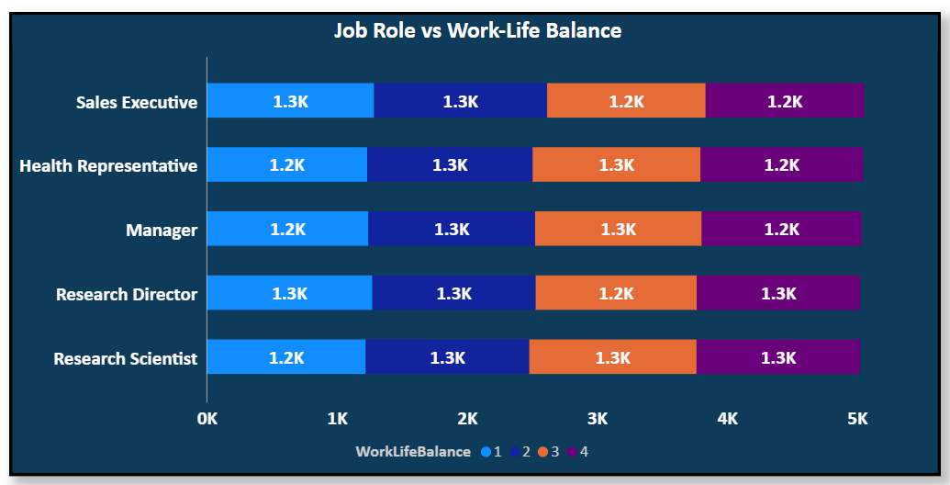
KPI 5 – Work-Life Balance by Job Role
Key Observations
Work-life balance varies significantly across job roles.
Some roles experience high stress and lower satisfaction.
Customer satisfaction is strongly linked to delivery Balanced roles show better retention and productivity.
Business Insight
Poor work-life balance leads to stress and increased attrition.
Flexible work policies can improve employee satisfaction and productivity.

Slide 8
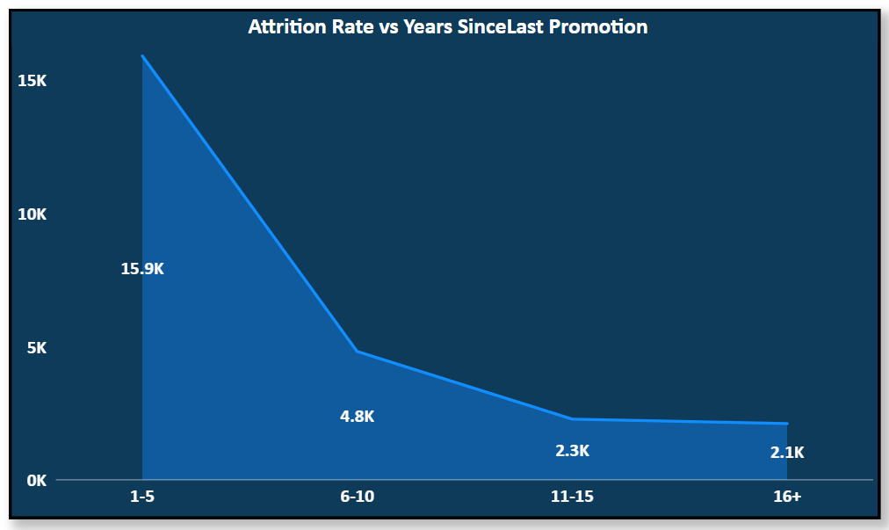
KPI 6 – Attrition vs Years Since Last Promotion
Key Observations
Employees with longer gaps since last promotion have higher attrition.
Recently promoted employees show higher retention.
Career stagnation is a major reason for employee exits.
Business Insight
Employees without promotions are more likely to leave.
Providing career growth opportunities helps retain talent.

Slide 9
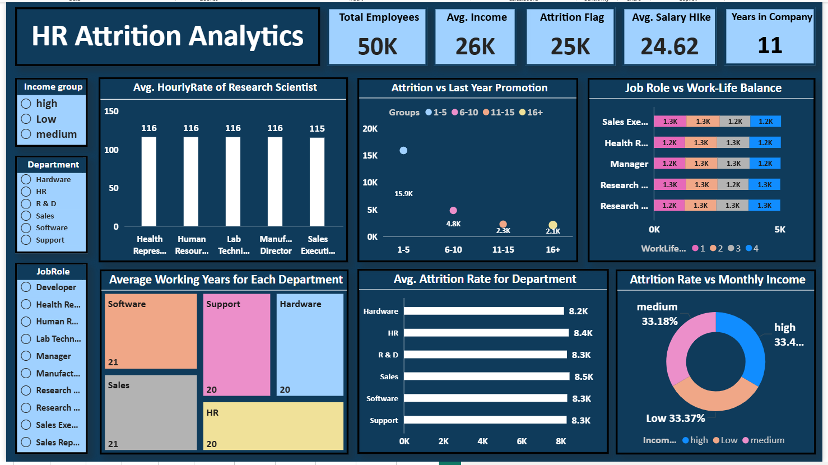
Power BI Dashboard

Slide 10
SQL Queries Used
#KPI1
CREATE TABLE KPI1 AS
SELECT
Department,
ROUND(SUM(CASE WHEN Attrition = 'Yes' THEN 1 ELSE 0 END) * 100.0 / COUNT(*), 2 ) AS Attrition_Rate_Percentage
FROM employees
GROUP BY Department;
SELECT * FROM KPI1;
#KPI2
CREATE TABLE KPI2 AS
SELECT ROUND(AVG(HourlyRate), 2) AS Avg_Hourly_Rate
FROM employees
WHERE Gender = 'Male'AND JobRole = 'Research Scientist’;
SELECT * FROM KPI2;

Slide 11
SQL Queries Used
#KPI3
CREATE TABLE KPI3 AS
SELECT
CASE
WHEN MonthlyIncome < 5000 THEN 'Low'
WHEN MonthlyIncome BETWEEN 5000 AND 10000 THEN 'Medium'
ELSE 'High' END AS Income_Category,
ROUND( SUM(CASE WHEN Attrition = 'Yes' THEN 1 ELSE 0 END) * 100.0/ COUNT(*), 2) AS Attrition_Rate
FROM employees
GROUP BY Income_Category;
SELECT * FROM KPI3;
#KPI4
CREATE TABLE KPI4 AS
SELECT
Department,
ROUND(AVG(TotalWorkingYears), 2) AS Avg_Working_Years
FROM employees
GROUP BY Department;
SELECT * FROM KPI4;

Slide 12
SQL Queries Used
#KPI5
CREATE TABLE KPI5 AS
SELECT
JobRole,
WorkLifeBalance,
COUNT(*) AS Employee_Count
FROM employees
GROUP BY JobRole, WorkLifeBalance
ORDER BY JobRole, WorkLifeBalance;
SELECT * FROM KPI5;

Slide 13
SQL Queries Used
#KPI6
CREATE TABLE KPI6 AS
SELECT
CASE
WHEN YearsSinceLastPromotion BETWEEN 1 AND 5 THEN '1-5’
WHEN YearsSinceLastPromotion BETWEEN 6 AND 10 THEN '6-10’
WHEN YearsSinceLastPromotion BETWEEN 11 AND 15 THEN '11-15'
WHEN YearsSinceLastPromotion BETWEEN 16 AND 20 THEN '16-20'
WHEN YearsSinceLastPromotion BETWEEN 21 AND 25 THEN '21-25'
WHEN YearsSinceLastPromotion BETWEEN 26 AND 30 THEN '26-30'
WHEN YearsSinceLastPromotion BETWEEN 31 AND 35 THEN '31-35'
WHEN YearsSinceLastPromotion BETWEEN 36 AND 40 THEN '36-40'
ELSE 'Other'
END AS Promotion_Group,
ROUND(
SUM(CASE WHEN Attrition = 'Yes' THEN 1 ELSE 0 END) * 100.0
/ COUNT(*), 2 ) AS Attrition_Rate
FROM employees
GROUP BY Promotion_Group
ORDER BY Promotion_Group;
SELECT * FROM KPI6;

Slide 14
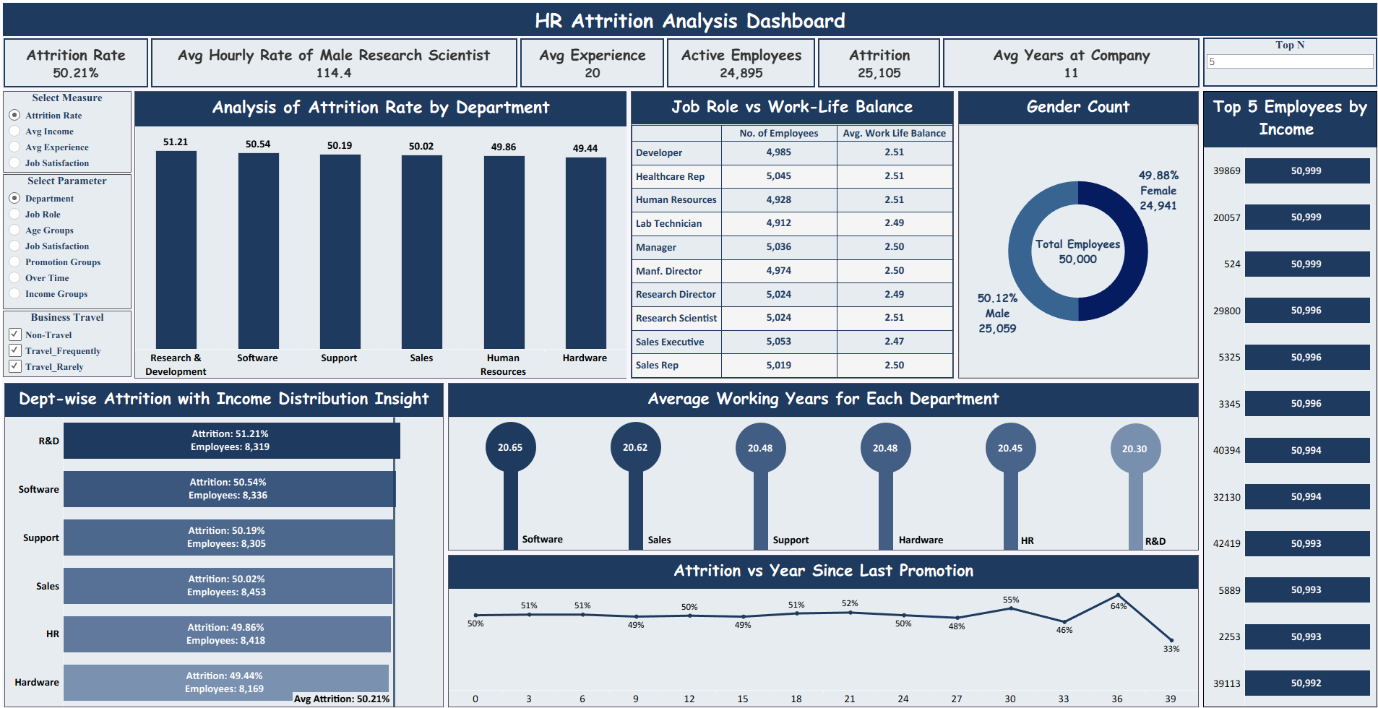
Tableau Dashboard

Slide 15
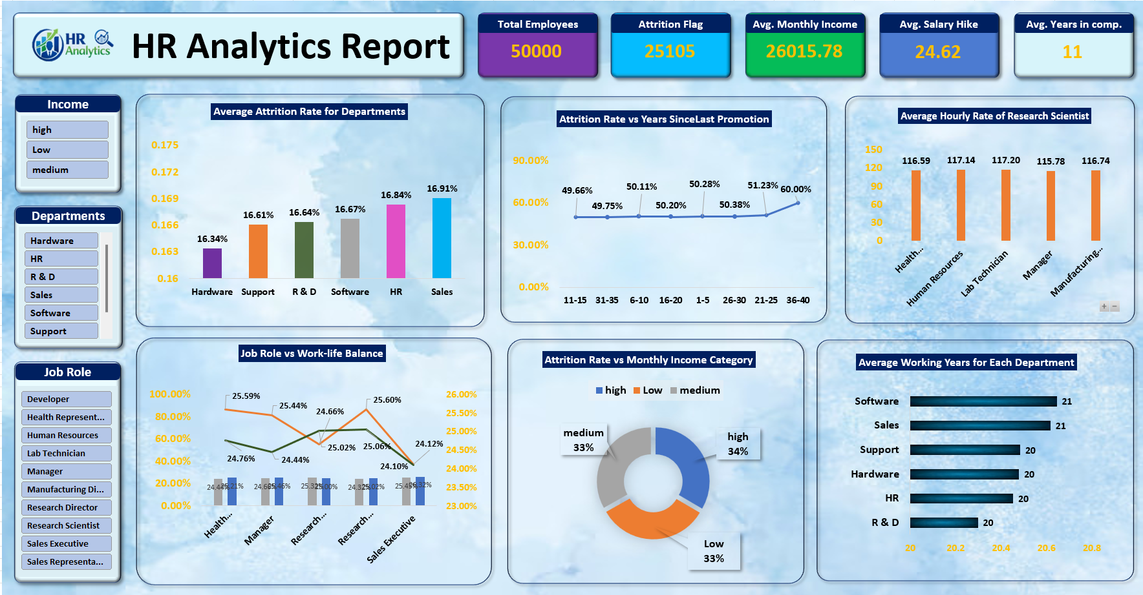
Excel Dashboard

Slide 16
Conclusion & Recommendations
Strategic Business Insights
Key Conclusions
Recommendations
High attrition is observed in Sales and low-income employees, indicating job pressure and compensation-related issues
Employees without timely promotions show higher exit rates due to lack of career growth opportunities
Work-life balance significantly impacts employee retention, with higher stress leading to increased turnover
Salary, job satisfaction, and growth opportunities are the key drivers influencing employee behavior
Employee engagement and recognition levels also play an important role in retention
Improve salary structure and introduce incentives for low-income employees to enhance retention.
Provide timely promotions, training, and clear career growth paths to keep employees motivated.
Enhance work-life balance through flexible policies and better workload management.
Focus on employee engagement, feedback systems, and support in high-attrition departments.
Implement regular performance reviews and recognition programs to boost morale.

Slide 17
Challenges Faced & How We Overcame Them
Challenges
Solution
Raw dataset had missing values and inconsistent formats, which affected calculations and analysis.
Difficulty in correctly calculating attrition rate (initial confusion between % of total vs actual ratio).
Creating consistent KPIs across Excel, SQL, Tableau, and Power BI was challenging.
Issues in grouping fields like Income Category and Promotion Range for meaningful analysis.
Performance issues in Power BI due to large dataset and multiple visuals.
Cleaned and standardized data in Excel and SQL by handling missing values and correcting formats
Used proper logic (CASE WHEN / Attrition Flag) to calculate accurate attrition rate.
Cross-verified KPIs across tools to maintain consistency in results.
Created calculated columns for Income Category and Promotion Groups to simplify analysis.
Optimized Power BI by removing unnecessary columns and reducing visuals for better performance.
implemented consistent visual design principles in Power BI/Tableau, selecting appropriate charts for KPIs.

Slide 18
Thank You

